Slide 1
MXCuBE | LIMS site report
Wenming Qin
National Facility for Protein Science in Shanghai (NFPSS)
/Shanghai Synchrotron Radiation Facility (SSRF)
May, 2025

Slide 2
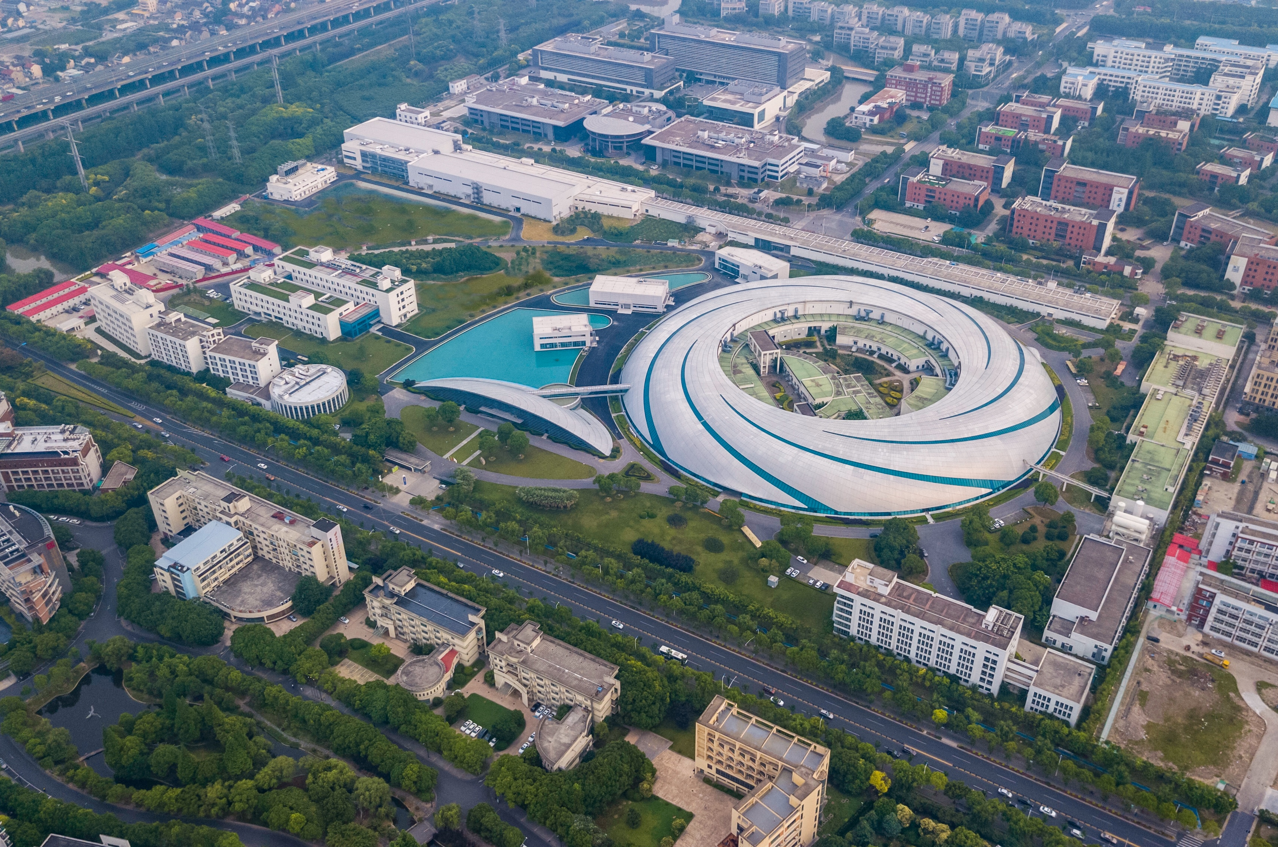
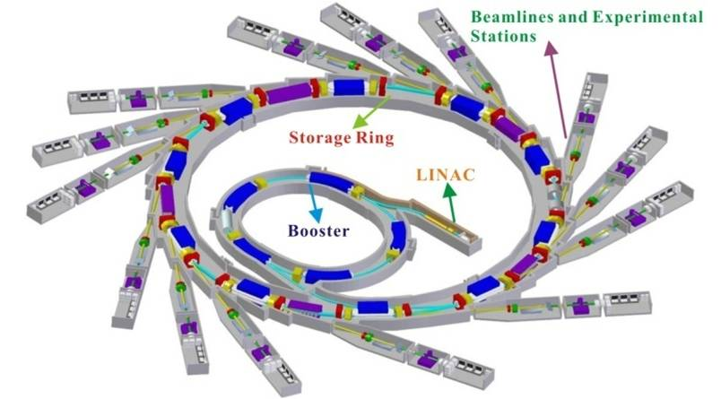
Shanghai Synchrotron Radiation Facility
SSRF Ring Parameters
Electron Energy：3.5 GeV
Electron Current: 300 mA
Circumference: 432 m
Straight sections: 20
Hard X-ray Free Electron Laser
Soft X-ray Free Electron Laser
SSRF

Slide 3

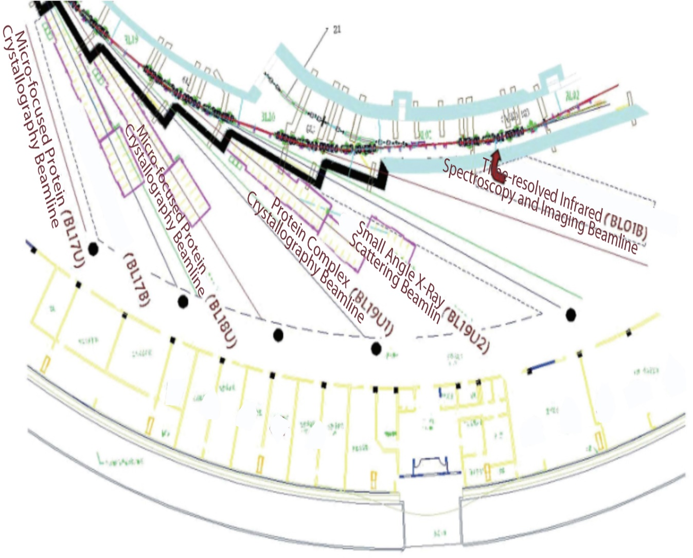
National Facility for Protein Science . Shanghai
NFPS passed the National Acceptance Review, and formally opened to the users in July 2015.
NFPS is composed of 9 technology systems with state-of-the-art instruments in its Haike Road Campus and 5 Beamlines within the Shanghai Synchrotron Radiation Facility.

Slide 4
MX Beamlines at SSRF
BL17B
6 MX Beamlines
BL18U1
NFPSS
MXCube
BL19U1
Shanghai Tech
BL17UM
BL02U1
SSRF
BL10U1

Slide 5
MXCuBE Version
BL17B:
mxcubeweb version:3.1.0
mxcubecore version:0.1.0
BL18U1:
mxcubeweb version:3.1.0
mxcubecore version:1.0.0
BL19U1:
mxcubeweb version:3.1.0
mxcubecore version:1.0.0

Slide 6
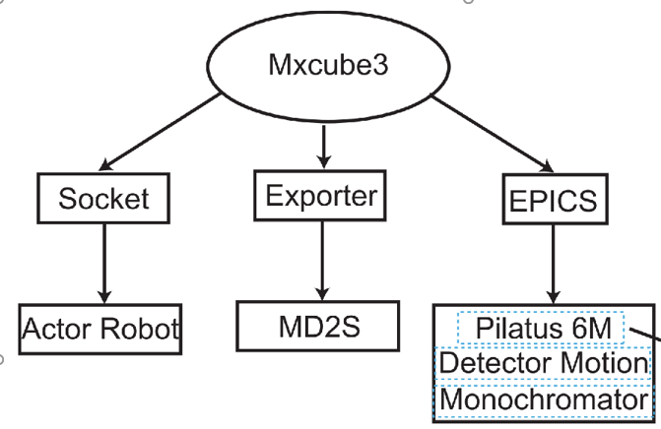
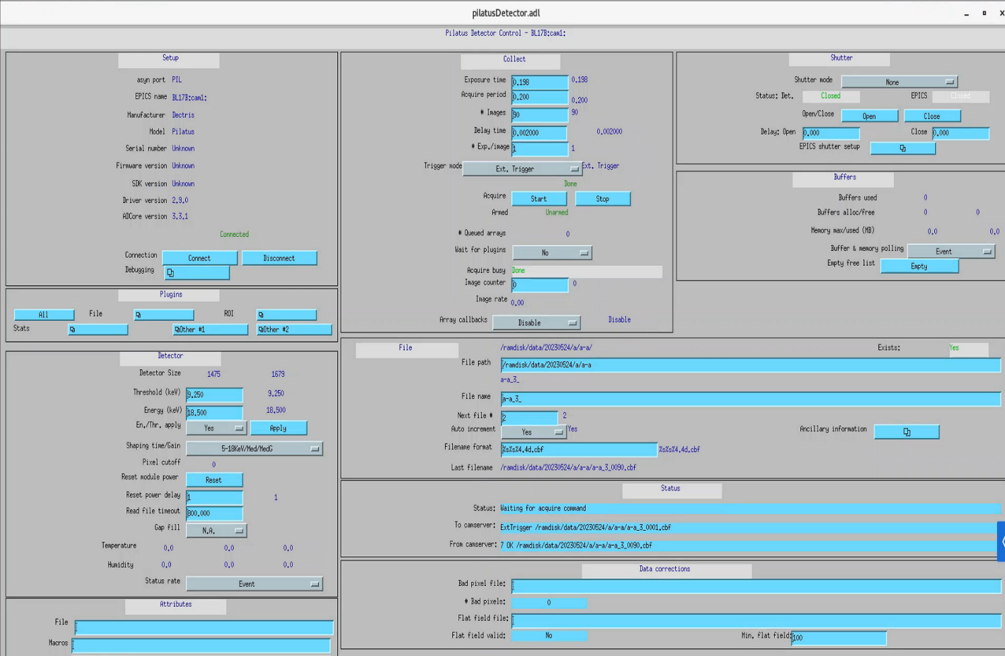
MXCUBE Status
Other development
Integrate Actor sample changer into mxcube.
Integrate FLEX sample changer into mxcube
Use EPICS to control the Pilatus detector and most of the motors.

Slide 7
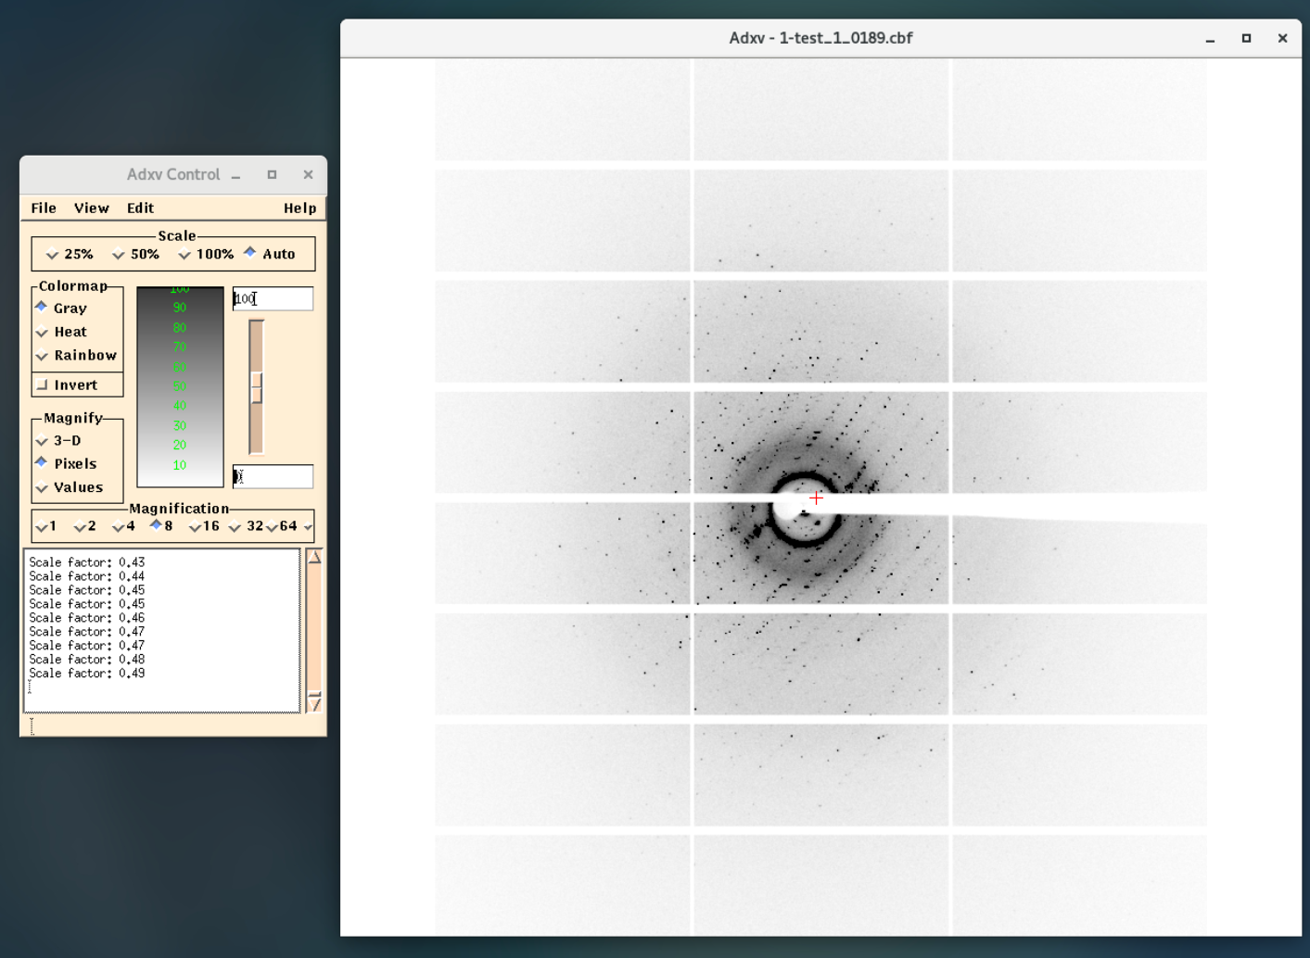
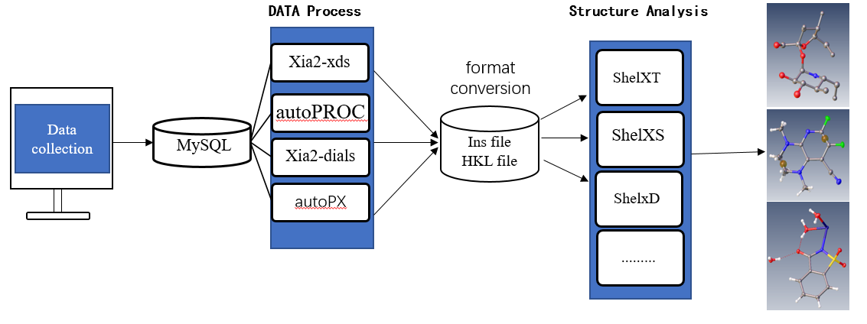
MXCUBE Status
Other development
Auto update diffraction pattern in adxv / Braggy.
Deploy four types of auto processing pipeline.

Slide 8
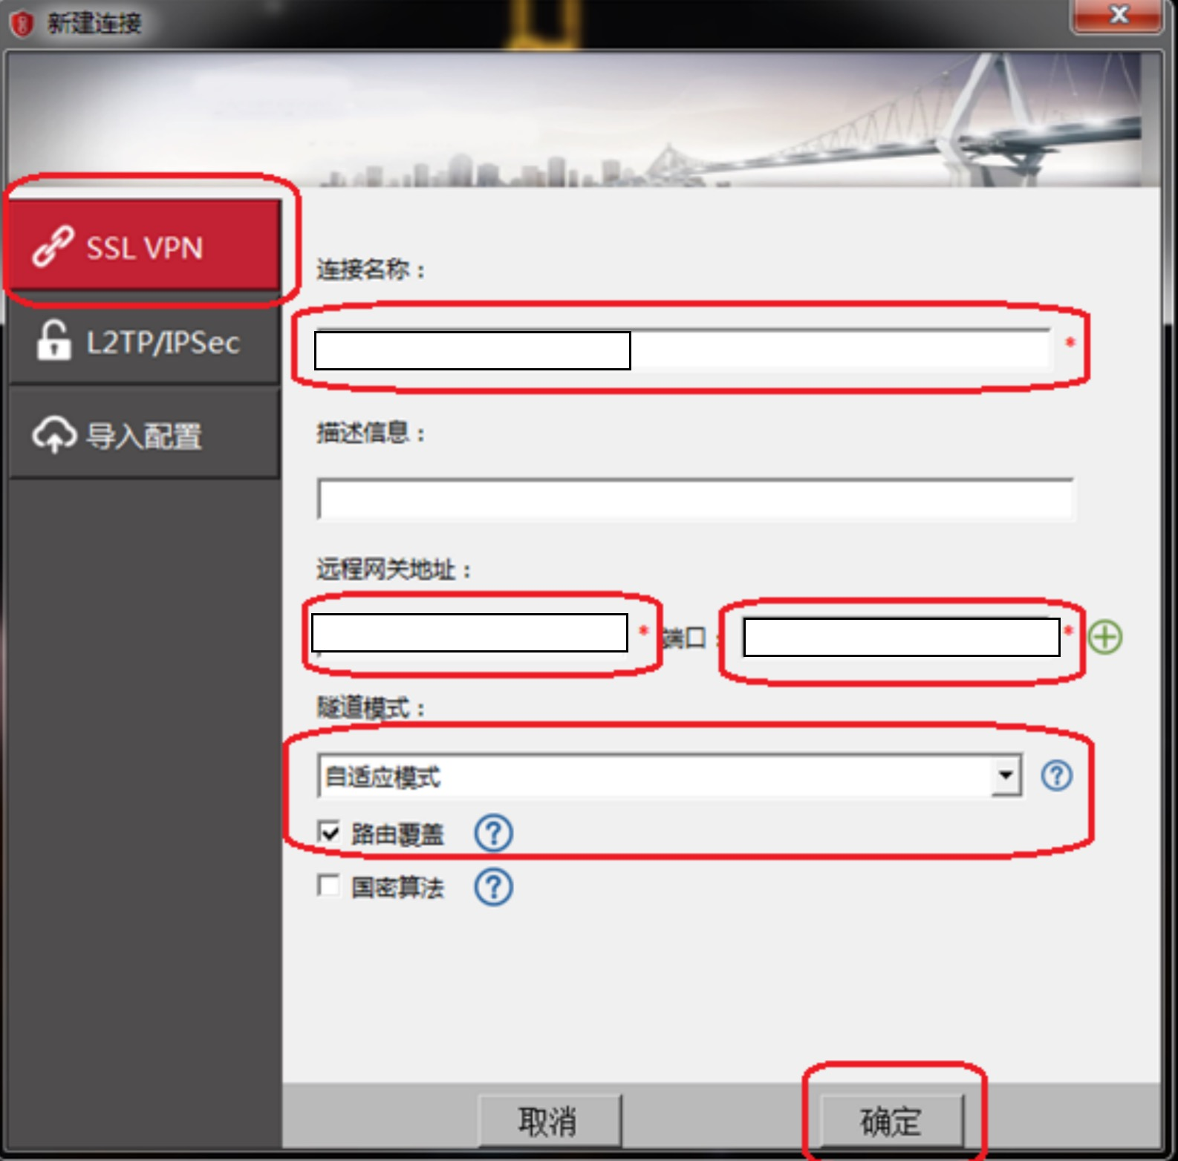
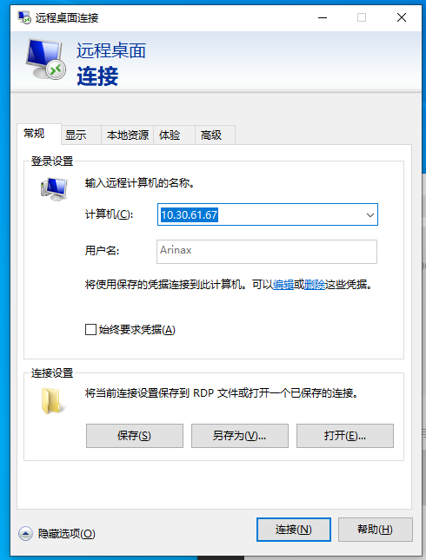
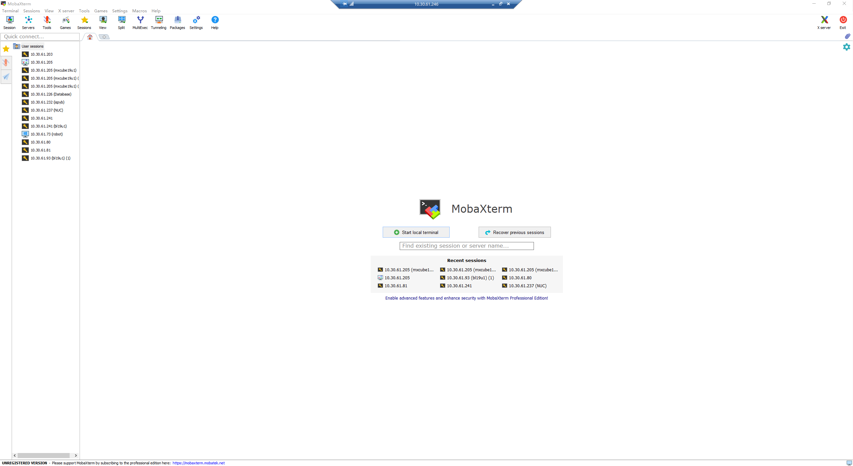
MXCUBE Status
Cybersecurity (other measures)
Most of servers in beamline only connect to the internal network.
Use VPN to connecto only one Windows PC remotely
Use MobaXterm or Browser (for virture system) to connect to other system through the PC connceted with VPN

Slide 9
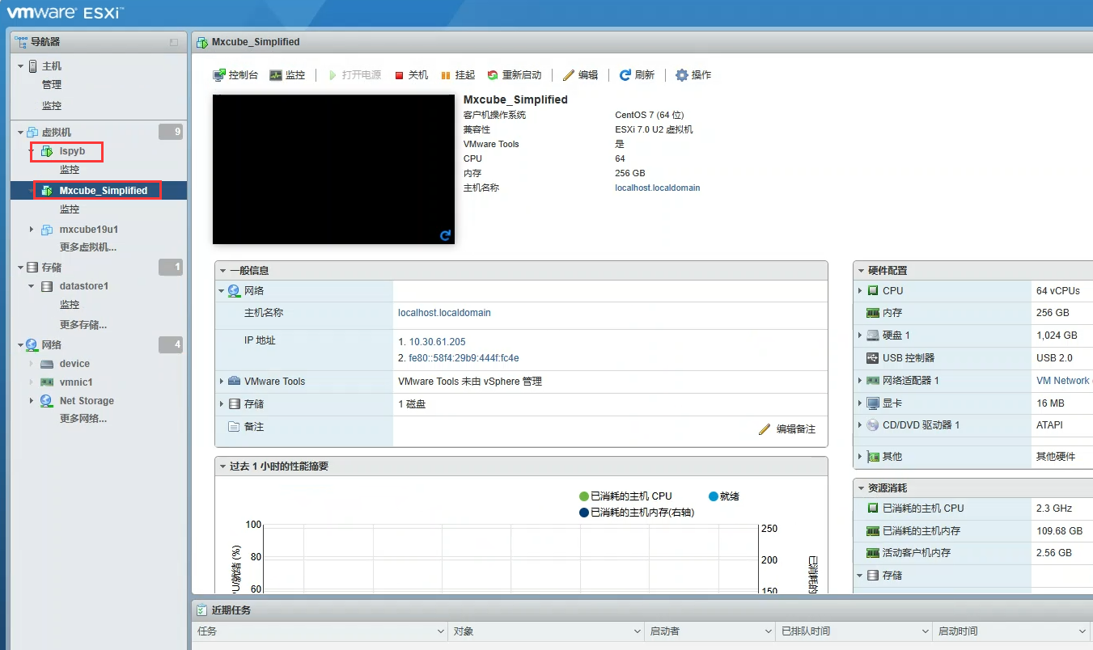
MXCUBE Status
Cybersecurity (virtual machine)
Use VMware to run mxcube and ispyb, take snapshot for insurance.
Browser (for virture system) to connect to other system through the PC connceted with VPN

Slide 10
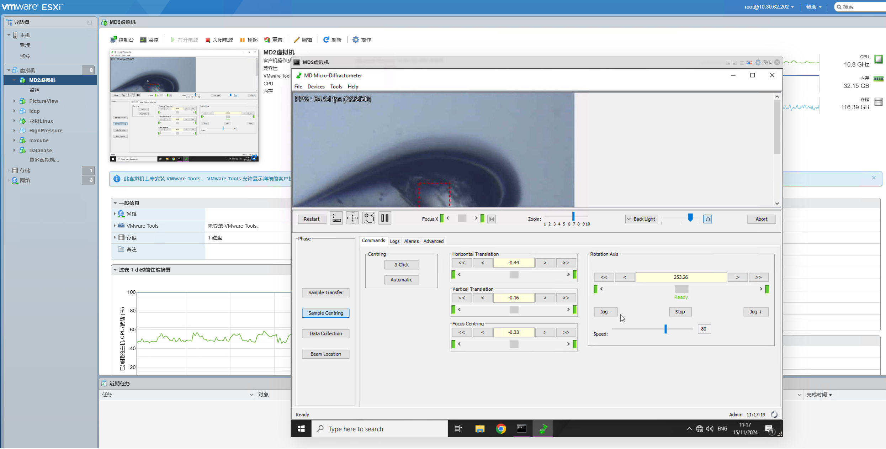
Developments since last meeting
Deploy MD2 computer into virtual machine

Slide 11
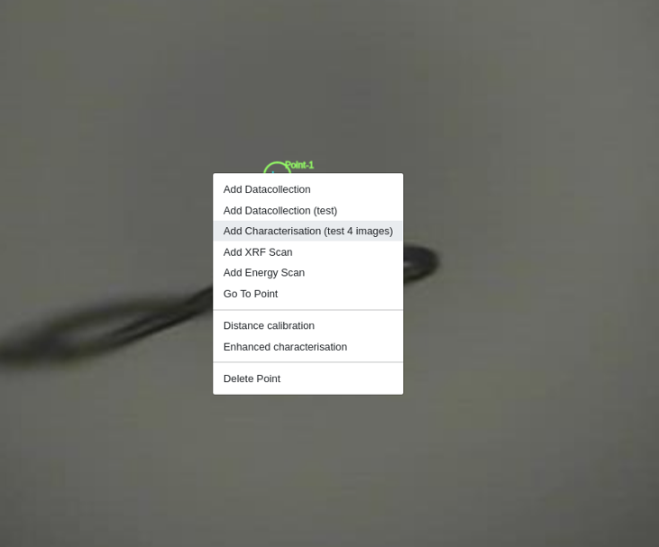
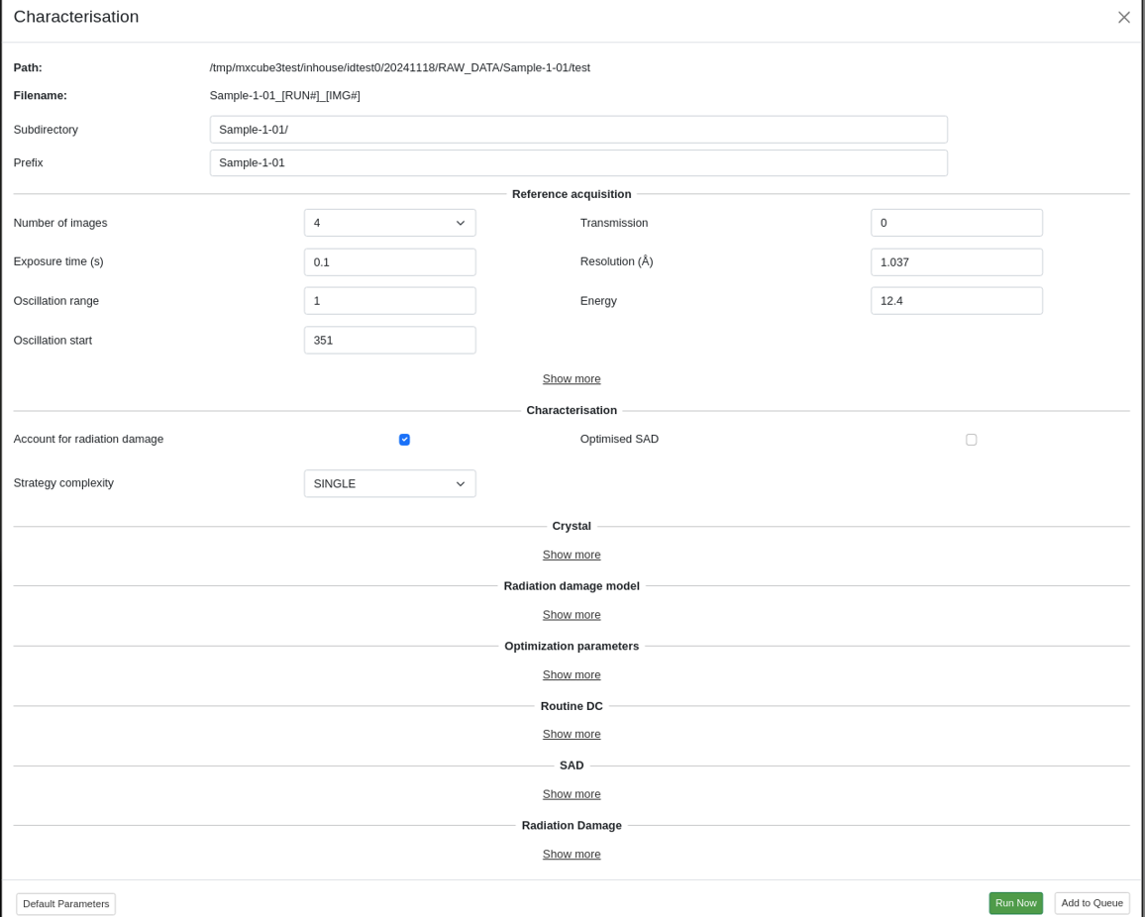
Developments since last meeting
Configure and make characteristic collection available in bl19u1.
( Maybe because that the method we use to control detector from mxcube is through epics,
we found the original code was not suitable ,so we rewrite most of code related to this function.)

Slide 12
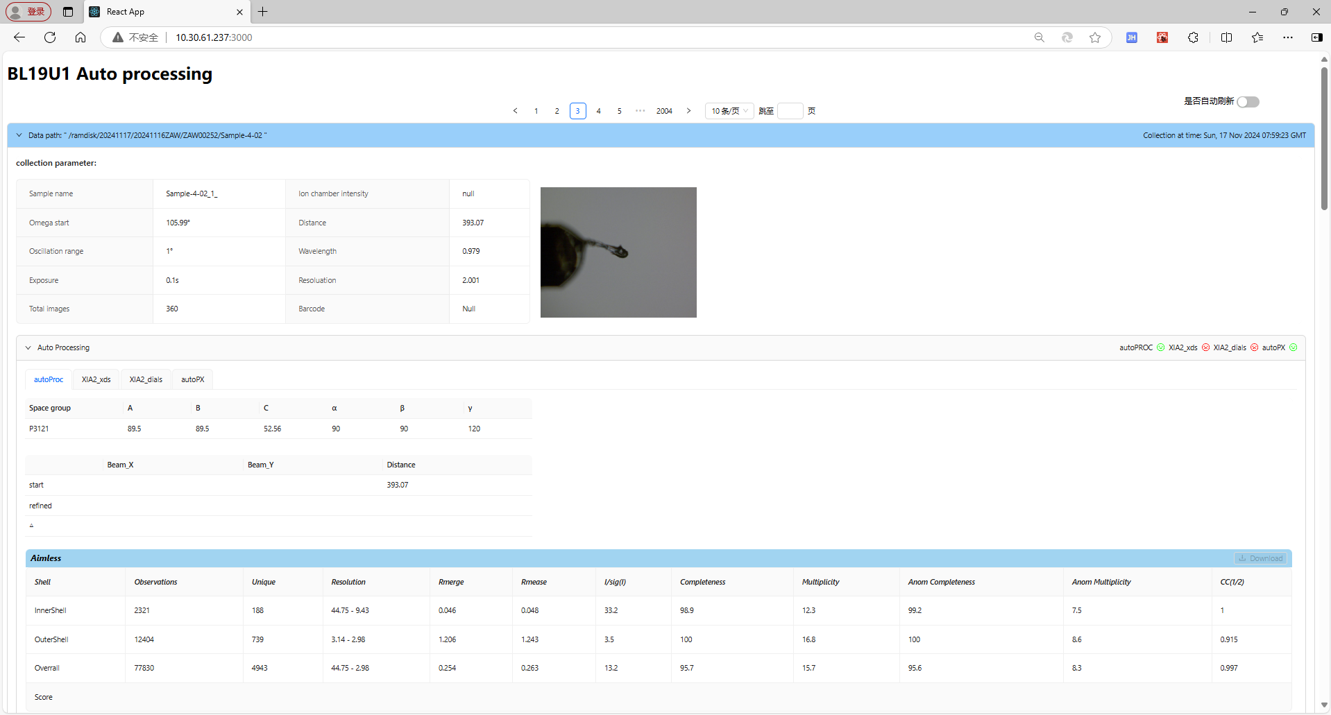
Developments since last meeting
Change the UI of auto processing pipeline.
4 auto processing method
(use the SynchWeb of Diamond Light Source as reference .)

Slide 13
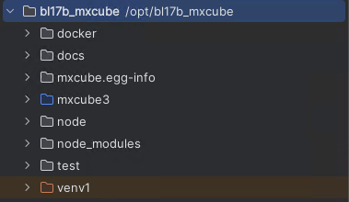
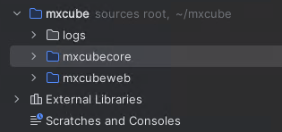
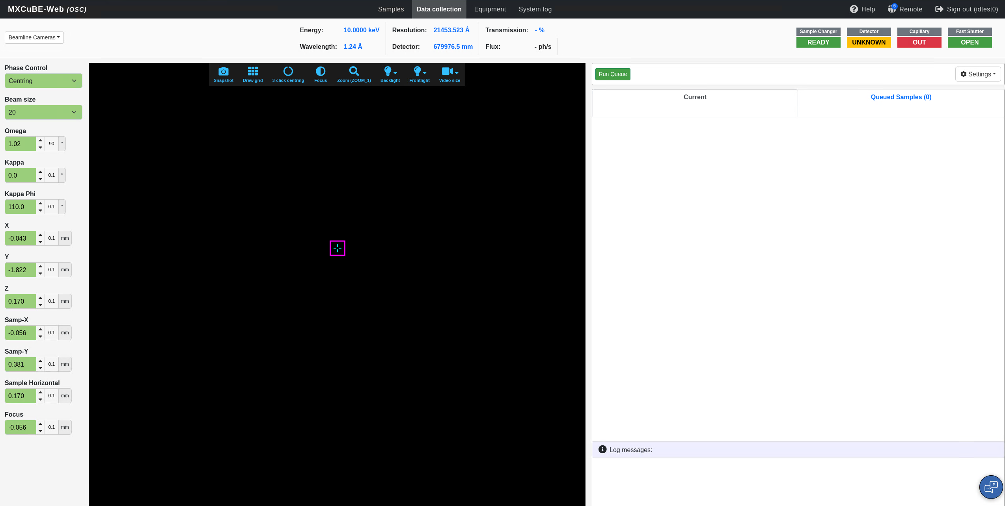
Developments since last meeting
Update the BL17B beamline mxcube to the latest version from 2022.2 to 2024.10.
1.The file structure is clearer.
Old version
New version
2. The front-end has not changed much, and features will be added later as needed.

Slide 14
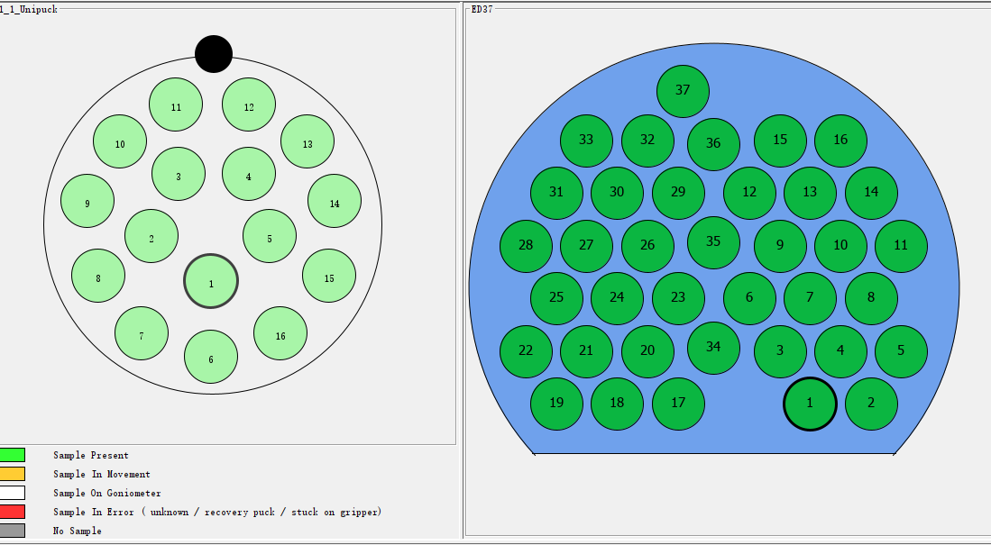
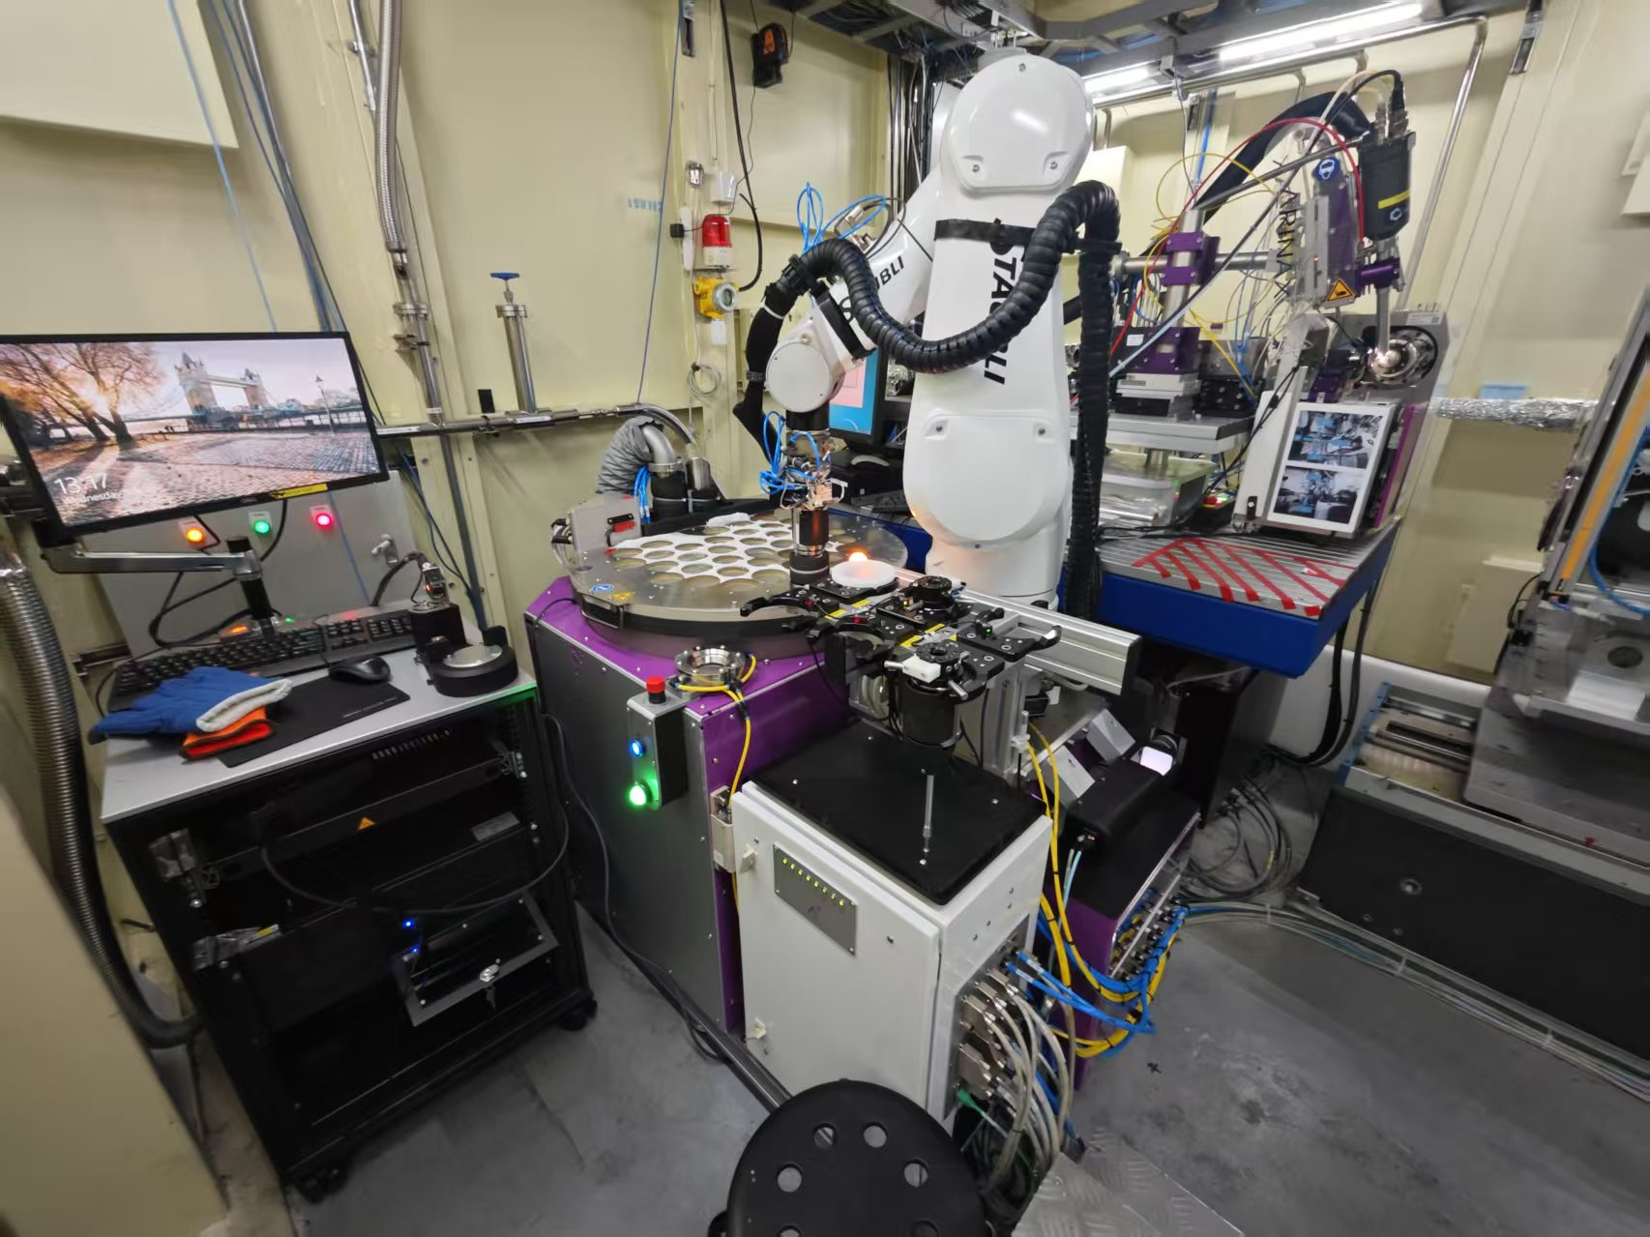
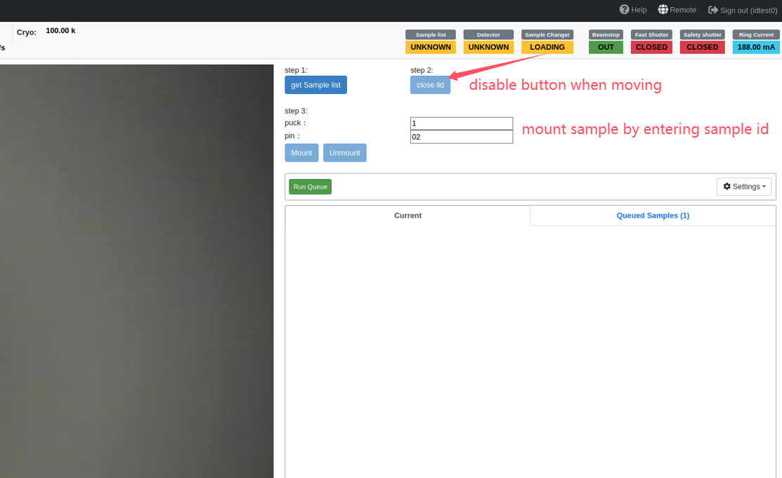
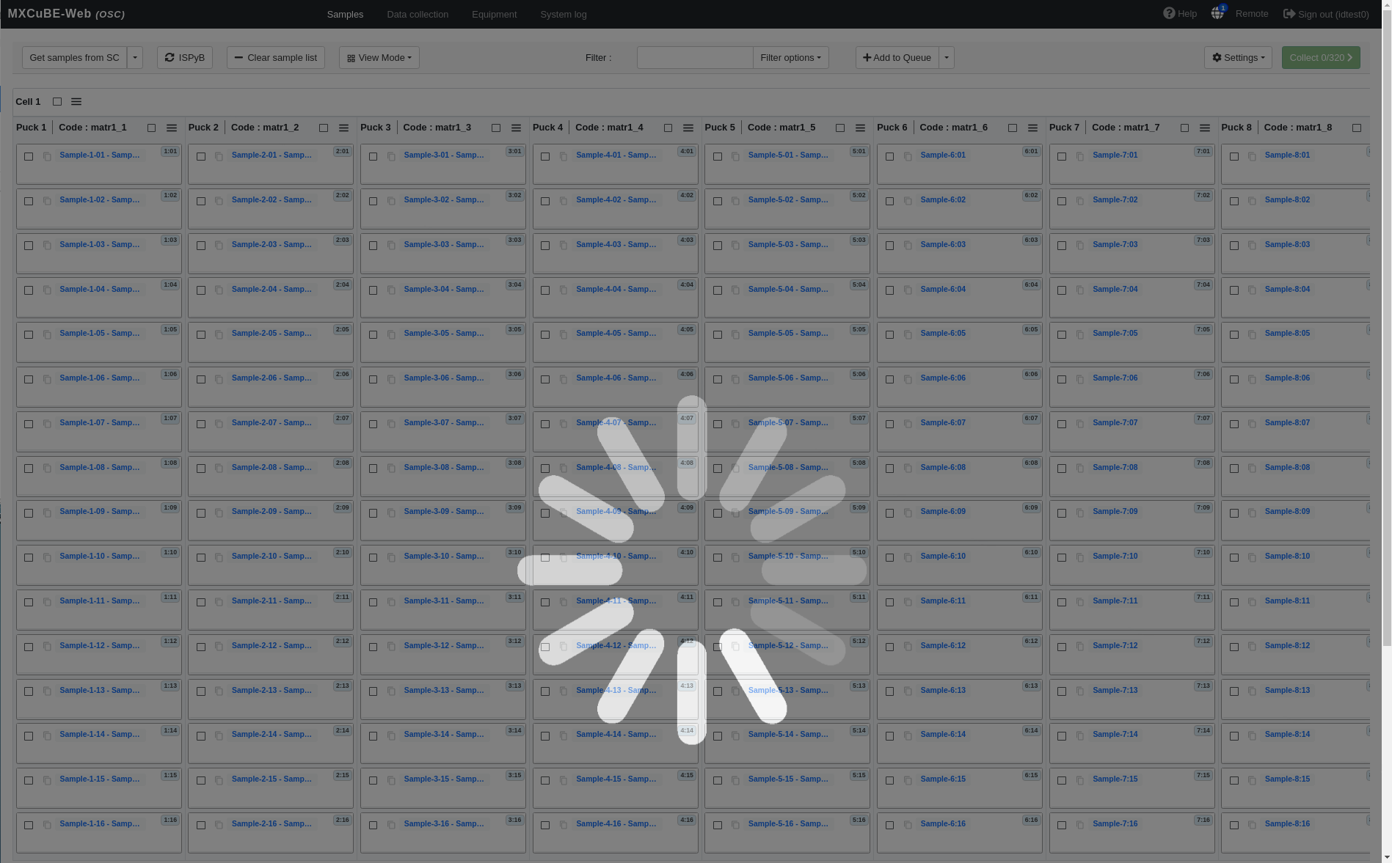
Developments since last meeting
Change the UI of mxcube to prepare for the integration of Flex sample changer
puck number increased to 37
Mount sample by type the puck and
smaple ID
React component may stuck when loading

Slide 15
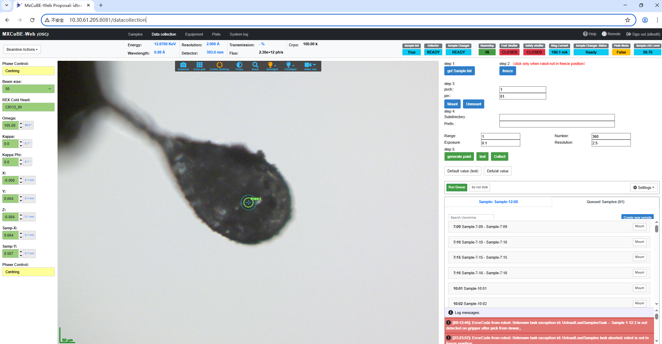
Updates and Adjustments to the MXCUBE Data Collection Interface
Sample change
Parameter Settings

Slide 16
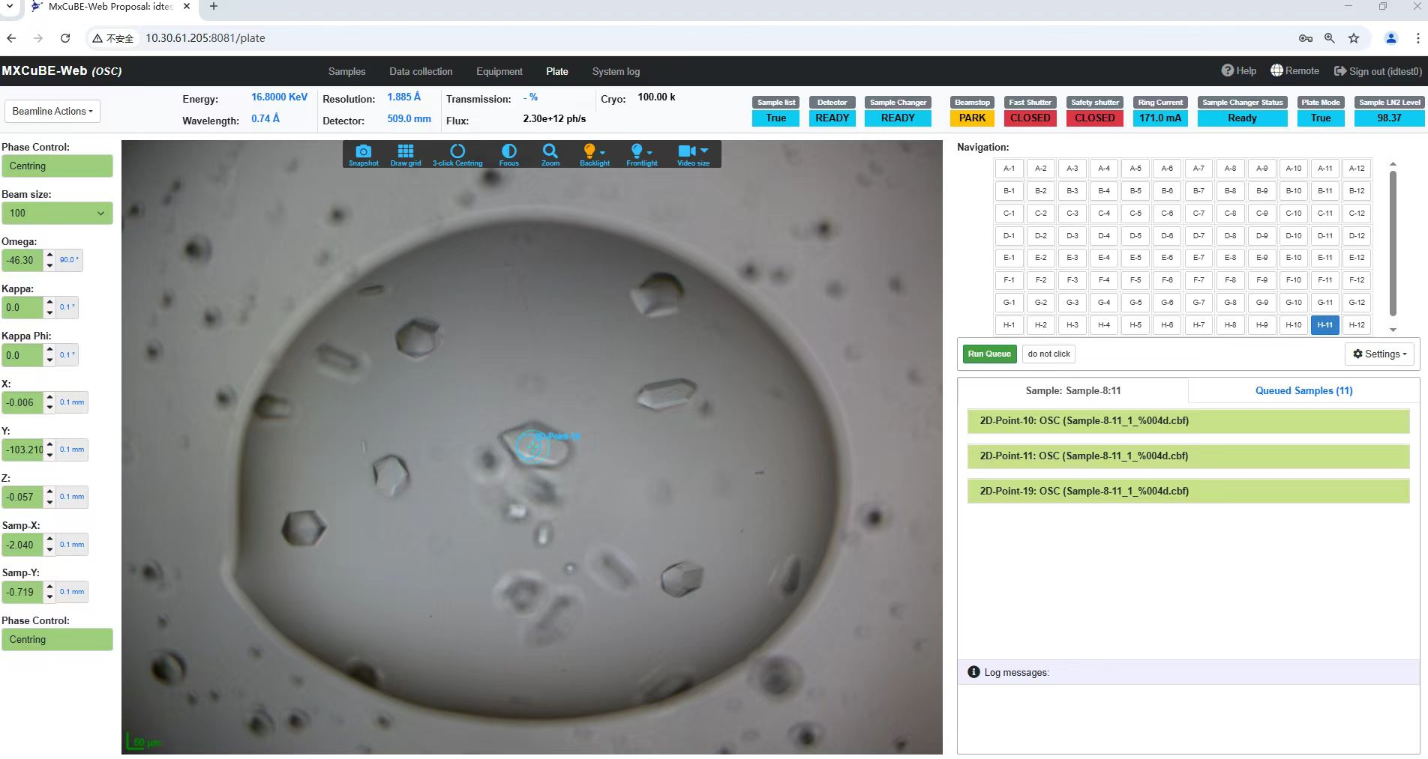
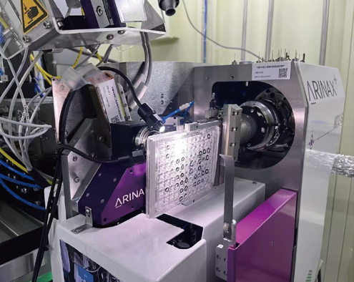
Integration of the in situ crystallization plate diffraction interface into MXCuBE3

Slide 17
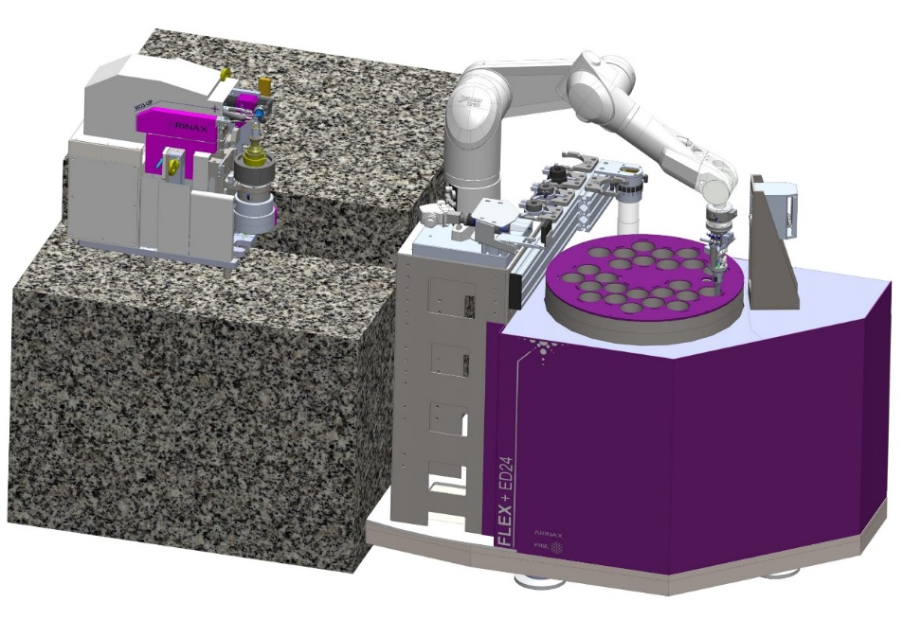
Plans for the next six months
Raster Scan and Helical Scan.
Complete the configuration of ISPyB and connect the database with MXCuBE.
Lims
FLEX-ED35

Slide 18
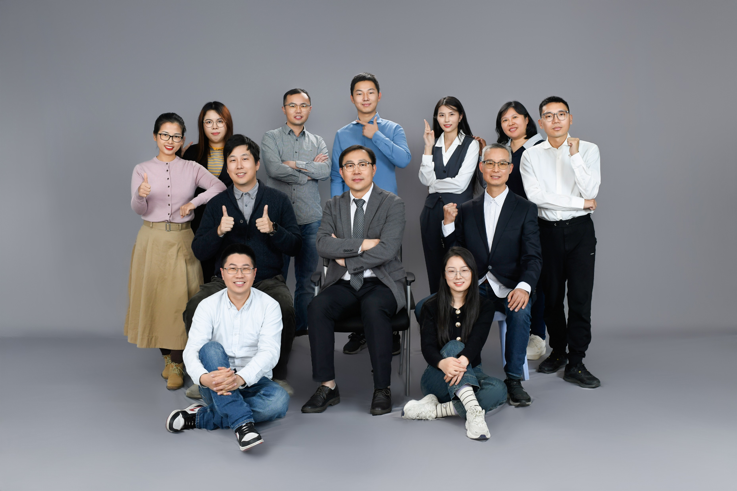
Thank you for your attention!

